Slide 2
Topics
Introduction to Repetition Structures
The while Loop: a Condition-Controlled Loop
The for Loop: a Count-Controlled Loop
Calculating a Running Total
Sentinels (value indicate the end of data)
Input Validation Loops
Nested Loops
Using break, continue, and else with Loops
Turtle Graphics: Using Loops to Draw Designs

Slide 3
Introduction to Repetition Structures
Often must write code that performs the same task multiple times
Disadvantages to duplicating code
Makes program large
Time consuming
May need to be corrected in many places
Repetition structure: makes computer repeat included code as necessary

Slide 4
Condition-Controlled and Count-Controlled Loops
There are two broad categories of loops:
Condition-controlled
uses a true/false condition to control the number of times the loop iterates
Count-controlled
repeats a specific number of times

Slide 5
The while Loop: a Condition-Controlled Loop
while loop: while condition is true, do something
Two parts:
Condition tested for true or false value
Statements repeated as long as condition is true
In flow chart, line goes back to previous part
General format:
while condition:
statements

Slide 6
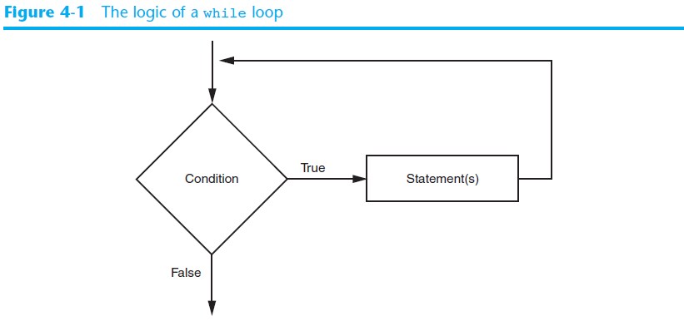
The while Loop: a Condition-Controlled Loop (cont’d.)

Slide 7
The while Loop: a Condition-Controlled Loop (cont’d.)
In order for a loop to stop executing, something has to happen inside the loop to make the condition false
Iteration: one execution of the body of a loop
while loop is known as a pretest loop
Tests condition before performing an iteration
Will never execute if condition is false to start with
Requires performing some steps prior to the loop

Slide 8
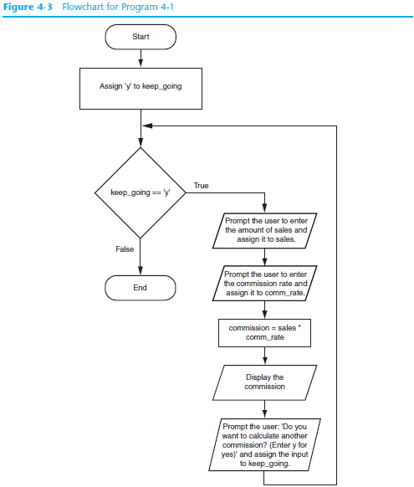

Slide 9
Infinite Loops
Loops must contain within themselves a way to terminate
Something inside a while loop must eventually make the condition false
Infinite loop: loop that does not have a way of stopping
Repeats until program is interrupted
Occurs when programmer forgets to include stopping code in the loop

Slide 10
Using the while Loop as a Count-Controlled Loop
The while loop is inherently a condition-controlled loop
It repeats as long as a Boolean condition is true
However, you can use the while loop as a count-controlled loop by pairing it with a counter variable
A counter variable is assigned a unique value during each iteration of a loop.
It is called a counter variable because it can be used to count the number of times the loop iterates

Slide 11
Using the while Loop as a Count-Controlled Loop
A count-controlled while loop must perform three actions:
Initialization: The counter variable must be initialized to a suitable starting value before the loop begins.
Comparison: The loop must compare the counter variable to a suitable ending value, to determine whether the loop should iterate or not.
Update: During each iteration, the loop must update the counter variable with a new value.

Slide 12
Using the while Loop as a Count-Controlled Loop
Example
Initialization: The variable n is initialized with 0
Comparison: The loop iterates as long as n is less than 5
Update: 1 is added to n
Initialization
n = 0
while n < 5:
print(f'Inside the loop, the value of n is {n}.')
n += 1
Comparison
Update

Slide 13
Single-Line while Loops
If there is only one statement in the body of a while loop, you can write the entire loop on one line.
General format: while condition: statement
Example: n = 0 while n < 10: n += 1

Slide 14
The for Loop: a Count-Controlled Loop
Count-Controlled loop: iterates a specific number of times
Use a for statement to write count-controlled loop
Designed to work with sequence of data items
Iterates once for each item in the sequence
General format:
for variable in [val1, val2, etc]:
statements
Target variable: the variable which is the target of the assignment at the beginning of each iteration

Slide 15
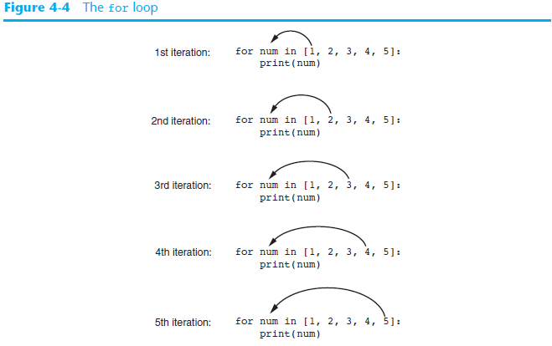

Slide 16
Using the range Function with the for Loop
The range function simplifies the process of writing a for loop
range returns an iterable object
Iterable: contains a sequence of values that can be iterated over
range characteristics:
One argument: used as ending limit
Two arguments: starting value and ending limit
Three arguments: third argument is step value

Slide 17
Using the Target Variable Inside the Loop
Purpose of target variable is to reference each item in a sequence as the loop iterates
Target variable can be used in calculations or tasks in the body of the loop
Example: calculate square root of each number in a range

Slide 18
Letting the User Control the Loop Iterations
Sometimes the programmer does not know exactly how many times the loop will execute
Can receive range inputs from the user, place them in variables, and call the range function in the for clause using these variables
Be sure to consider the end cases: range does not include the ending limit

Slide 19
Generating an Iterable Sequence that Ranges from Highest to Lowest
The range function can be used to generate a sequence with numbers in descending order
Make sure starting number is larger than end limit, and step value is negative
Example: range(10, 0, -1)

Slide 20
Calculating a Running Total
Programs often need to calculate a total of a series of numbers
Typically include two elements:
A loop that reads each number in series
An accumulator variable
Known as program that keeps a running total: accumulates total and reads in series
At end of loop, accumulator will reference the total

Slide 21
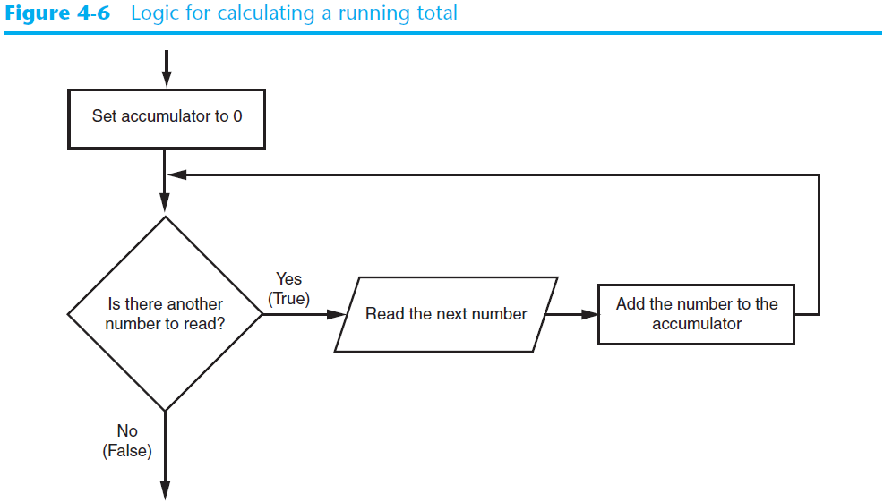
Calculating a Running Total (cont’d.)

Slide 22
The Augmented Assignment Operators
In many assignment statements, the variable on the left side of the = operator also appears on the right side of the = operator
Augmented assignment operators: special set of operators designed for this type of job
Shorthand operators

Slide 23
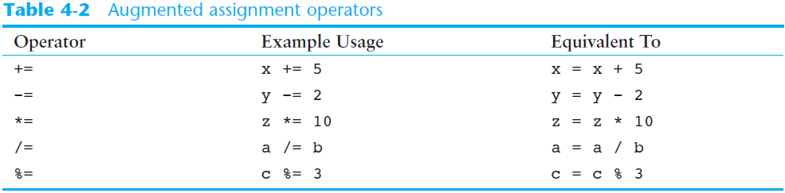
The Augmented Assignment Operators (cont’d.)

Slide 24
Sentinels
Sentinel: special value that marks the end of a sequence of items
When program reaches a sentinel, it knows that the end of the sequence of items was reached, and the loop terminates
Must be distinctive enough so as not to be mistaken for a regular value in the sequence
Example: when reading an input file, empty line can be used as a sentinel

Slide 25
Input Validation Loops
Computer cannot tell the difference between good data and bad data
If user provides bad input, program will produce bad output
GIGO: garbage in, garbage out
It is important to design program such that bad input is never accepted

Slide 26
Input Validation Loops (cont’d.)
Input validation: inspecting input before it is processed by the program
If input is invalid, prompt user to enter correct data
Commonly accomplished using a while loop which repeats as long as the input is bad
If input is bad, display error message and receive another set of data
If input is good, continue to process the input

Slide 27
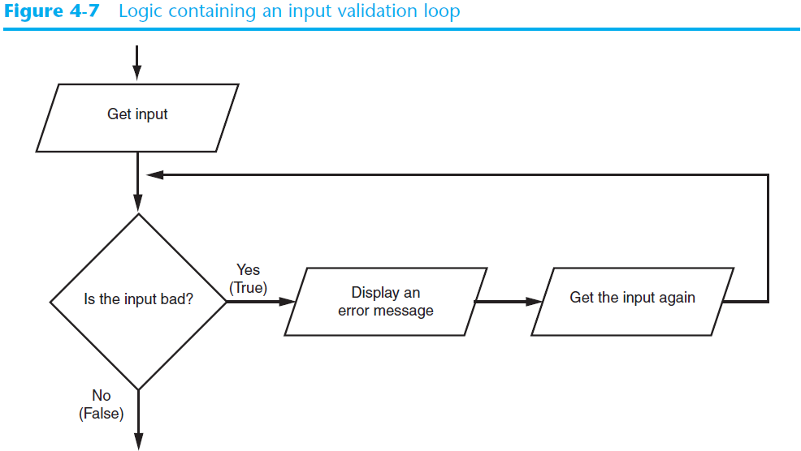
Input Validation Loops (cont’d.)

Slide 28
Input Validation Loops (cont’d.)
Using the walrus operator in an input validation loop
You can use the walrus operator to create an assignment expression that combines the priming read with the input validation loop
Example:
while (score := int(input('Enter your score: '))) < 0:
print('The score cannot be negative.'

Slide 29
Nested Loops
Nested loop: loop that is contained inside another loop
Example: analog clock works like a nested loop
Hours hand moves once for every twelve movements of the minutes hand: for each iteration of the “hours,” do twelve iterations of “minutes”
Seconds hand moves 60 times for each movement of the minutes hand: for each iteration of “minutes,” do 60 iterations of “seconds”

Slide 30
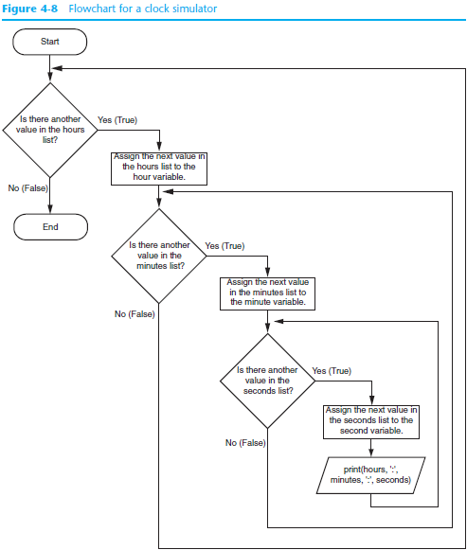

Slide 31
Nested Loops (cont’d.)
Key points about nested loops:
Inner loop goes through all of its iterations for each iteration of outer loop
Inner loops complete their iterations faster than outer loops
Total number of iterations in nested loop:
number of iterations of inner loop X number of iterations of outer loop

Slide 32
The break Statement
The break statement causes a loop to terminate
n = 0
while n < 100:
print(n)
if n == 5:
break
n += 1
print(f'The loop stopped and n is {n}.')
This statement causes the loop to stop
Program Output
0
1
2
3
4
5
The loop stopped and n is 5.

Slide 33
The continue Statement
The continue statement causes the current iteration of a loop to end early
When the continue statement is executed, all the statements in the body of the loop that appear after it are ignored, and the loop begins its next iteration (if there is a next iteration)

Slide 34
The continue Statement
Example:
n = 0
while n < 10:
n += 1
if n % 3 == 0:
continue
print(n)
This statement ends the current iteration and causes the loop to skip to the next iteration.
Program Output
1
2
4
5
7
8
10

Slide 35
The else Clause with a Loop
Loops in Python can have an optional else clause.
while condition:
statement
statement
etc.
else:
statement
statement
etc.
for variable in [value1, value2, etc.]:
statement
statement
etc.
else:
statement
statement
etc.

Slide 36
The else Clause with a Loop
An else clause in a loop is useful only when the loop contains a break statement.
The block of statements that appears after the else clause executes only when the loop terminates normally, without encountering a break statement.
If the loop terminates because of a break statement, the else clause will not execute its block of statements.

Slide 37
The else Clause with a Loop
Example:
for n in range(10):
if n == 5:
print('Breaking out of the loop.')
break
print(n)
else:
print(f'After the loop, n is {n}.')
Program Output
0
1
2
3
4
Breaking out of the loop.
The else clause did not execute because the break statement executed

Slide 38
The else Clause with a Loop
Example:
for n in range(3):
if n == 5:
print('Breaking out of the loop.')
break
print(n)
else:
print(f'After the loop, n is {n}.')
The break statement did not execute, so the else clause executed.
Program Output
0
1
2
After the loop, n is 2.

Slide 39
Turtle Graphics: Using Loops to Draw Designs
You can use loops with the turtle to draw both simple shapes and elaborate designs. For example, the following for loop iterates four times to draw a square that is 100 pixels wide:
for x in range(4):
turtle.forward(100)
turtle.right(90)

Slide 40
Turtle Graphics: Using Loops to Draw Designs
This for loop iterates eight times to draw the octagon:
for x in range(8):
turtle.forward(100)
turtle.right(45)

Slide 41
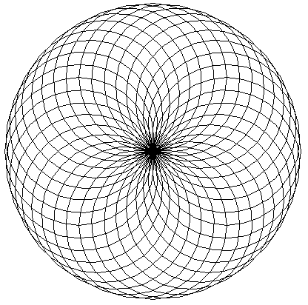
Turtle Graphics: Using Loops to Draw Designs
You can create interesting designs by repeatedly drawing a simple shape, with the turtle tilted at a slightly different angle each time it draws the shape.
NUM_CIRCLES = 36 # Number of circles to draw
RADIUS = 100 # Radius of each circle
ANGLE = 10 # Angle to turn
for x in range(NUM_CIRCLES):
turtle.circle(RADIUS)
turtle.left(ANGLE)

Slide 42
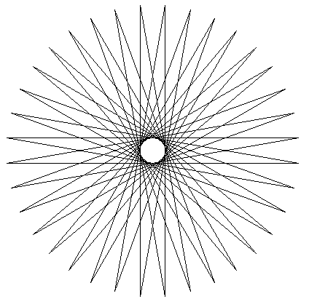
Turtle Graphics: Using Loops to Draw Designs
This code draws a sequence of 36 straight lines to make a "starburst" design.
START_X = -200 # Starting X coordinate
START_Y = 0 # Starting Y coordinate
NUM_LINES = 36 # Number of lines to draw
LINE_LENGTH = 400 # Length of each line
ANGLE = 170 # Angle to turn
turtle.hideturtle()
turtle.penup()
turtle.goto(START_X, START_Y)
turtle.pendown()
for x in range(NUM_LINES):
turtle.forward(LINE_LENGTH)
turtle.left(ANGLE)

Slide 43
Summary
This chapter covered:
Repetition structures, including:
Condition-controlled loops
Count-controlled loops
Nested loops
Infinite loops and how they can be avoided
range function as used in for loops
Calculating a running total and augmented assignment operators
Use of sentinels to terminate loops
Using loops to draw turtle graphic designs

